Slide 1
Voice-activated 3D Object Detection and Retrieval Routines
Michael Gomez - EE-4953/5663
December 5th, 2023
Notes:
In this project, I have implemented open-source software into an algorithm that detects the coordinates of an object within a defined 3D space for retrieval using an xArm 5 Lite robotic arm given a verbal input command.
Robots are highly versatile systems with a diverse range of applications in many fields, including health, civil engineering, and even agriculture. Robotic arms in particular have shown a lot of promise in these contexts, so there’s been recent interest in research focusing on automating the movement process utilizing computer vision. Then to further improve the efficiency and usability of this type of system for object retrievals, I decided to incorporate speech-recognition as well.

Slide 2


Project Chronology
P1
xArm 5 Lite Robotic Arm
Start Position
P2
Vosk Speech Recognition
Retrieval routine
P3
YOLOv5 Object Detection
Notes:
This project utilizes a microphone and Vosk speech recognition to receive a user's voice command, which will activate an overhead camera and a lateral camera, then run YOLOv5 object detection to locate an object's position. The robotic arm with a gripper attachment will then execute a retrieval routine and return to its initial position to repeat the process.

Slide 3
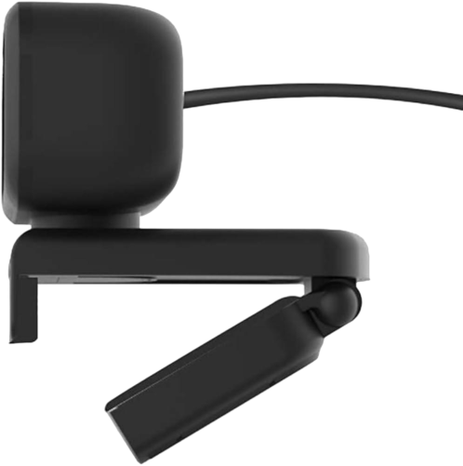
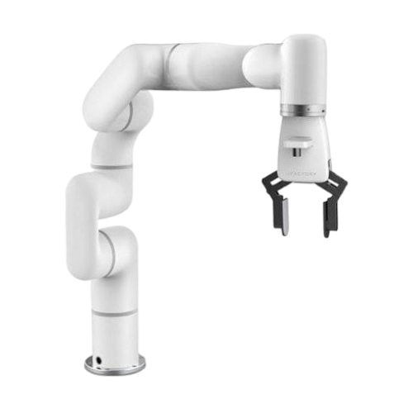
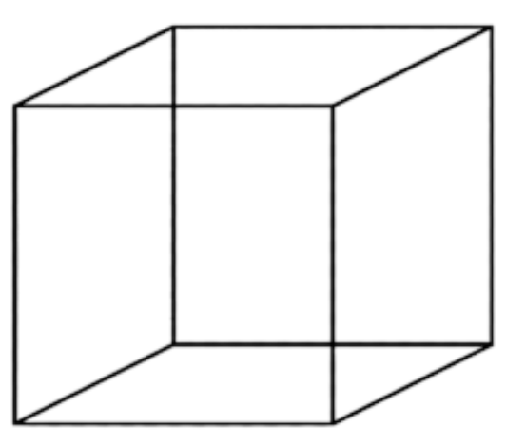
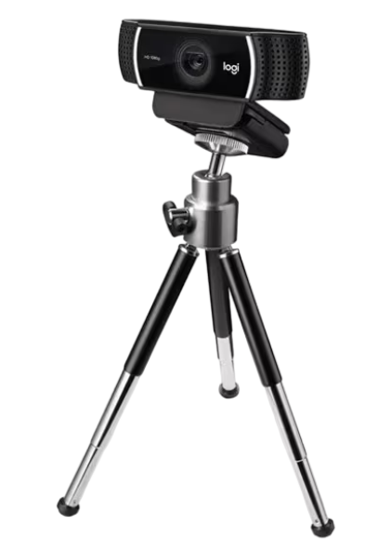
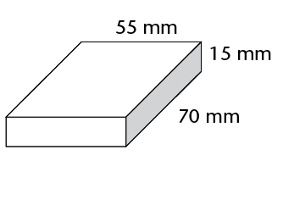
Usable Range of the xArm 5 Lite
Range is limited by mount location and gripper
Actual range (workspace) is the common ground between arm and cameras
X max = 490 mm
Y max = 385 mm
Z max = 500 mm
Workspace is defined as a rectangular prism within the operating range
Notes:
The actual range of motion is limited to the common area between the xArm and both cameras used to capture the given 3D space. The figure shows how the fields of vision intersect to form a working range for objects to be retrieved within.

Slide 4
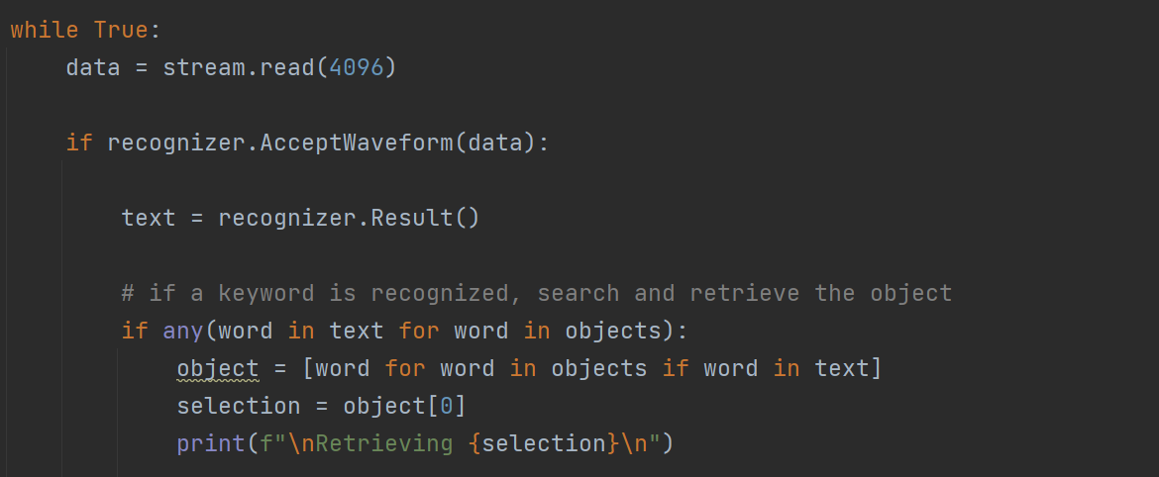

Vosk Speech-to-Text Implementation
Open-source engine that uses locally downloaded model
Works completely offline
Low latency
High accuracy transcriptions
Notes:
Upon activation, an audio stream begins that continually transcribes the user's input using the Vosk speech recognition small English model until a keyword to activate a retrieval routine is detected.
There are two routines:
Manual mode - the user says the name of an object, and the arm will fetch the first instance it can detect. If the object is not detected, the arm will wait idly until an instance is introduced into the environment.
Automatic mode - the user says "automatic," and the arm will dispose of all instances of trash. If there are no more instances detected, the arm will return to its initial position.

Slide 5
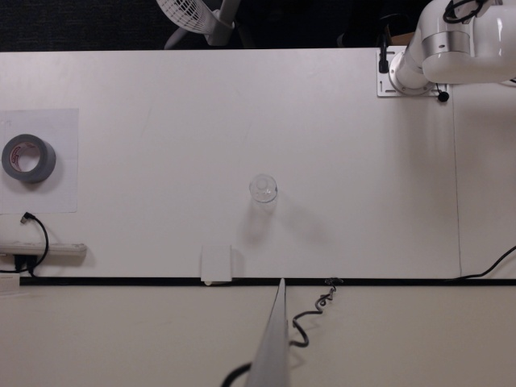
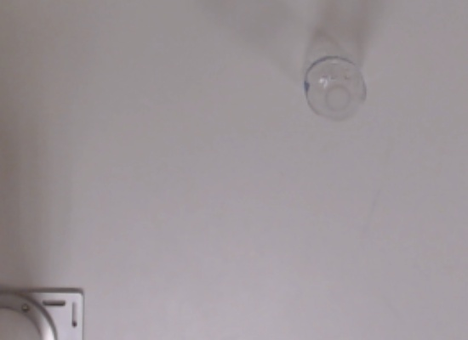
Webcam to Robot Perspective Transform
cv2.getPerspectiveTransform()
cv2.warpPerspective()
(504, 92)
(272, 91)
(271, 271)
(510, 270)
490 x 385
1 pixel = 1mm
640 x 480
Notes:
For the data preprocessing, the camera's coordinates are not inherently synced to the xArm's, so commands from the OpenCV library are used to correct the images it takes before running YOLOv5. Calibration is done by taking images of the arm at each of the four corners of the defined environment and finding the pixel coordinates. This aligns the robot with the coordinate system of the image.

Slide 6
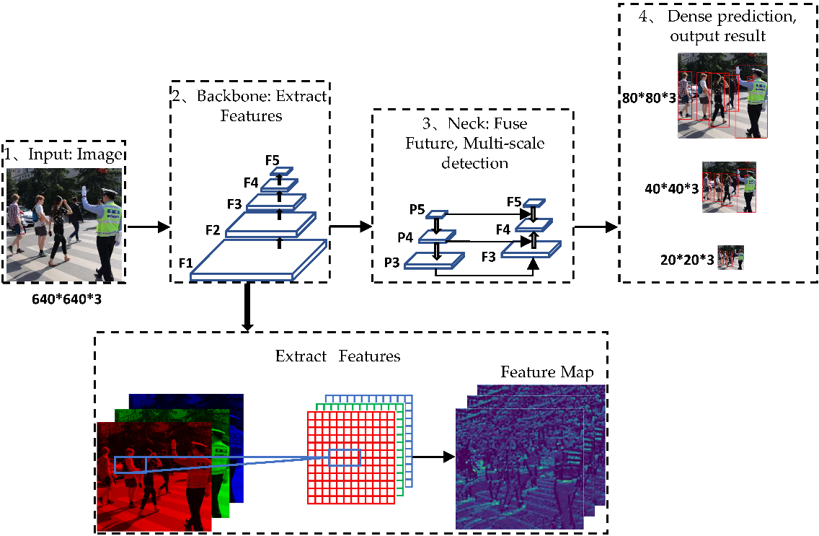
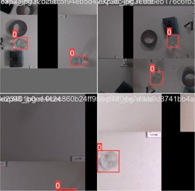
Custom Training YOLOv5
Trained on a dataset of a bottle from a bird's-eye view
189 training, 10 testing, 10 validation samples
Batch size of 32
Trained for 100 epochs
Notes:
For the dataset used, because the end effector is a simple, non-magnetic claw, I decided to test this algorithm on a "bottle" object class. So YOLOv5 is a single-stage object detector based on a pre-trained network that extracts features for the images fed into it and renders an output with bounding boxes. I annotated training images of a bottle from an aerial view because it was apparent from testing that YOLOv5 has a difficult time detecting objects from this perspective. You can see that to vary the data there was data augmentation such as simple transformation or noise added to the images.

Slide 7
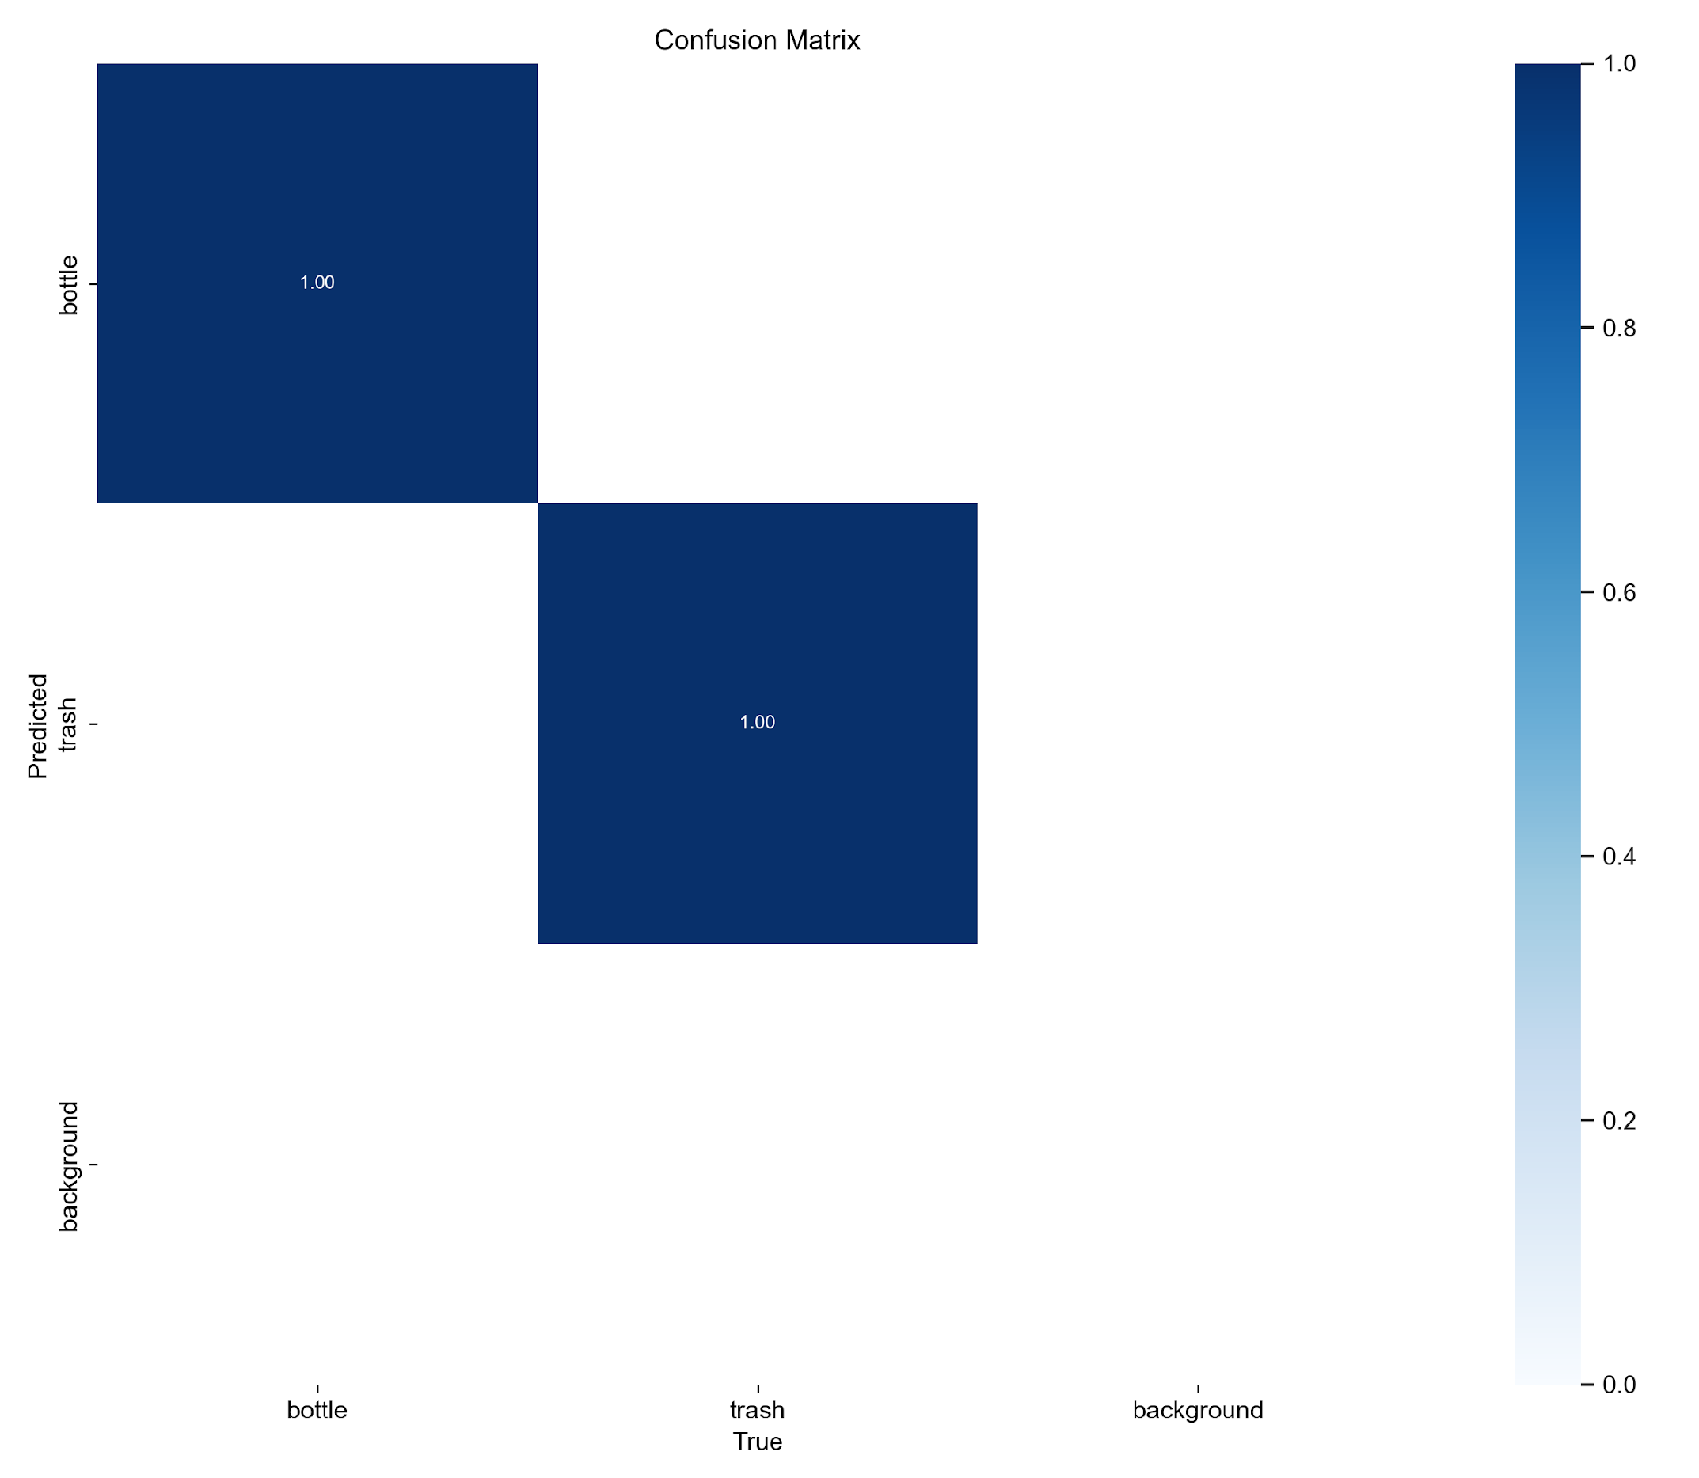
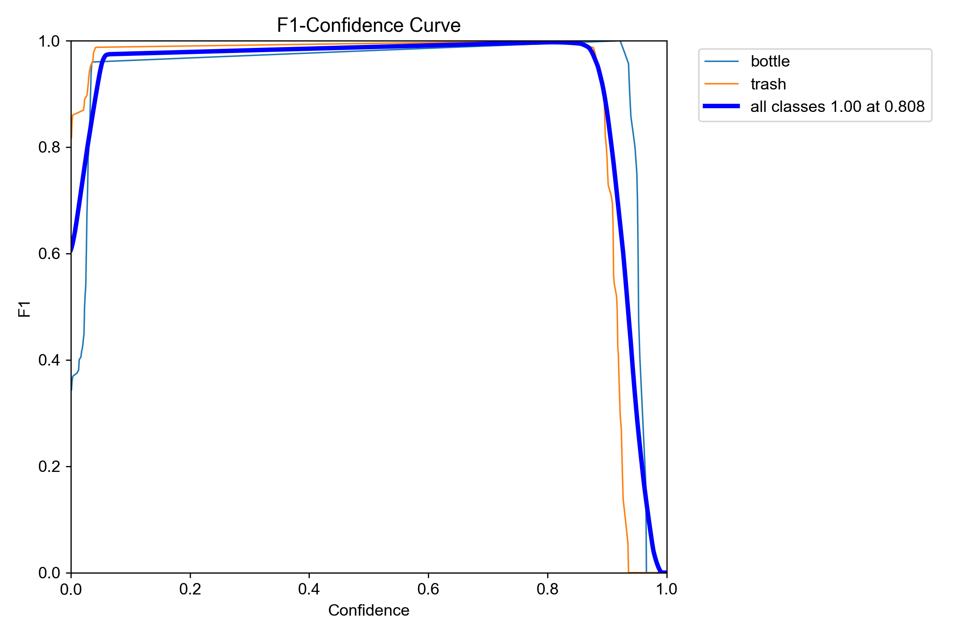
Test Set Results
Notes:
This class performed exceptionally well as a proof-of-concept for this routine, returning true positives for all testing samples as shown by the confusion matrix and F1 confidence that agrees at about 0.8.

Slide 8
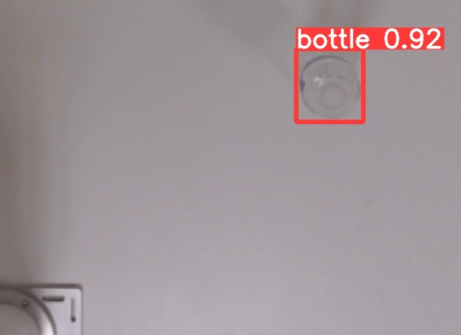
Image to Robot Coordinates
x2
x1
y1
y2
xArm's X and Y values are the average of the two bounding box coordinates
Box Centroid
Notes:
After detecting an object, the generated bounding box coordinates will be used to calculate the arm's X and Y position.

Slide 9
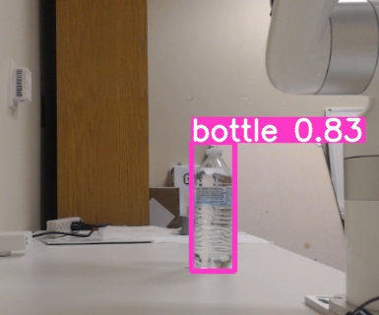
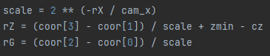
Image to Robot Coordinates (cont.)
g2
g1
Relative size of the object decreases with increasing rX value
Scale factor is determined as a function of rX and xArm's distance from the camera
z1
z2
385 x 320
Notes:
A challenge with applying similar methods to the ZY plane was that depth perception now plays a significant role in distorting the relationship between the coordinates and geometry of an object. To adjust for the relative size shift resulting from the distance an object is from the lateral camera, I created the scale factor equation shown that is applied to the coordinate difference to return the object’s actual height and width regardless of where it is located within the image.

Slide 10
Demo

